Slide 1
ServiceNow Studio

Slide 2
Studio
ServiceNow's Integrated Development Environment (IDE)
Used to enhance and build on the applications
To open Studio, use the Application Navigator to open System Applications > Studio.
Notes:
ServiceNow Studio provides an Integrated Development Environment (IDE)-like interface for developers to enhance and build on the applications in one centralized location.
To open Studio, use the Application Navigator to open System Applications > Studio.

Slide 3
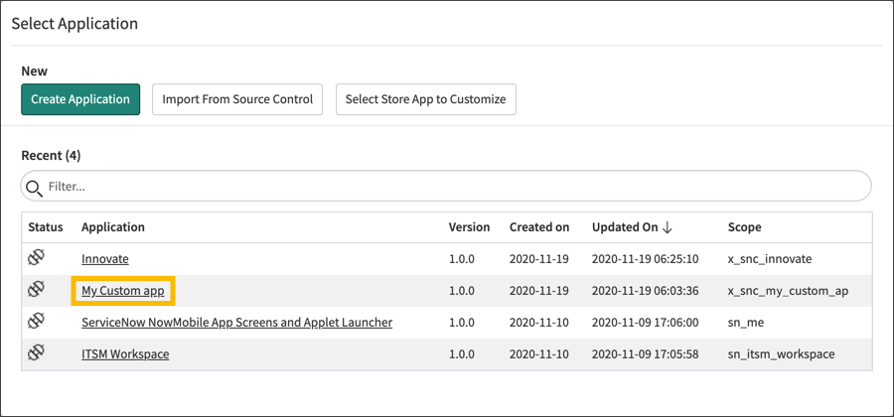
Studio
Notes:
In the Applications list, click an application to open it for editing in Studio. The number of applications in your list may be different from the list shown.

Slide 4
Capabilities
Create an application and application artifacts.
Perform code search.
Integrate with source control.
Create your company's customizations to store applications that belong to other organizations.
Notes:
The Capabilities of service now studio – ( continue reading slide )

Slide 5
Anatomy
Components
Header
Application Explorer
Content Frame
Status Bar
Notes:
The Components of ServiceNow Studio is

Slide 6
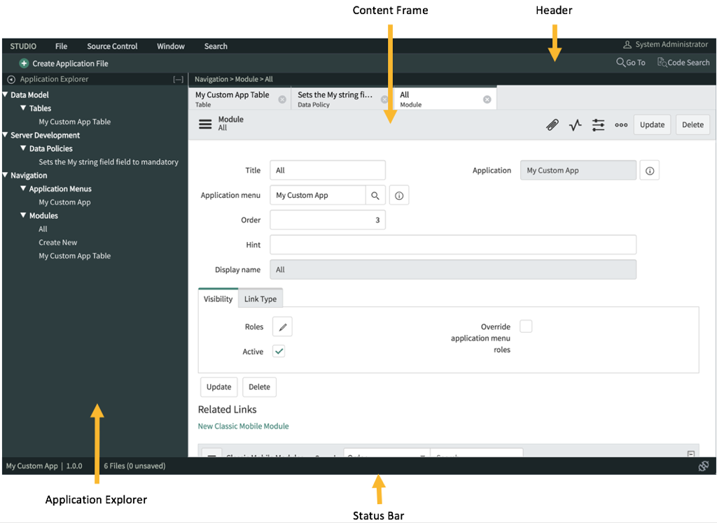
Anatomy

Slide 7
Header
Notes:
Header Contains the name of the logged-in user, menus and controls

Slide 8
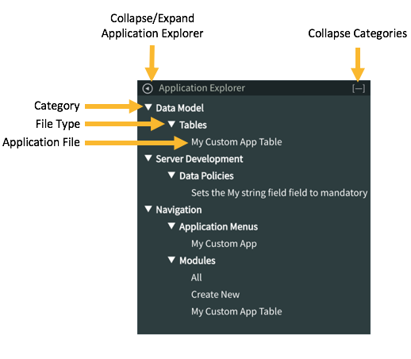
Application Explorer
Contains a list of application files organized by category

Slide 9
Content Frame
Displays the form for each application file's record.
The appearance and content of the form varies with file type.
Notes:
In the content Frame (Continue Reading)

Slide 10
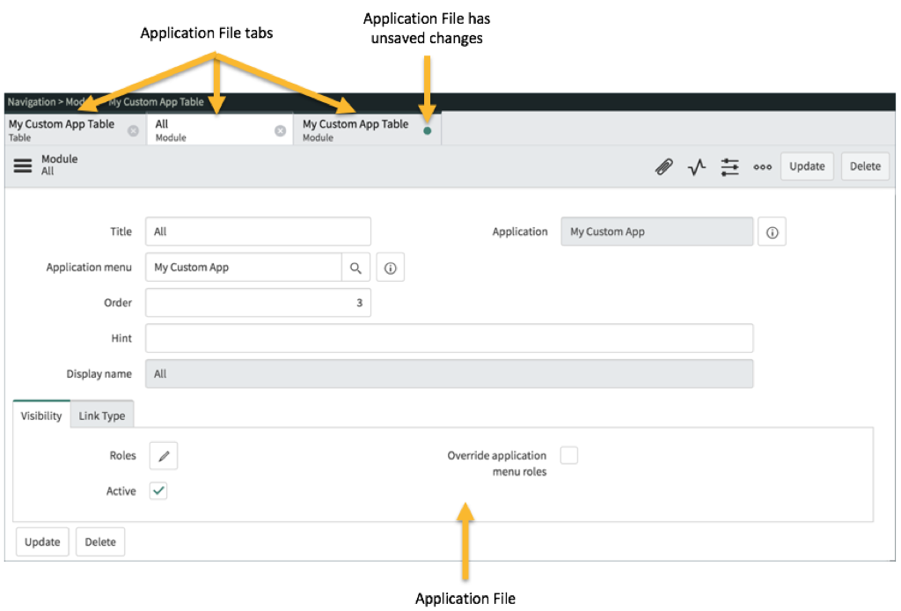
Content Frame
Notes:
In here we have 3 application file tabs,

Slide 11
Content Frame
Notes:
In the 3rd tab displays a blue dot indicating unsaved changes of an application file.

Slide 12
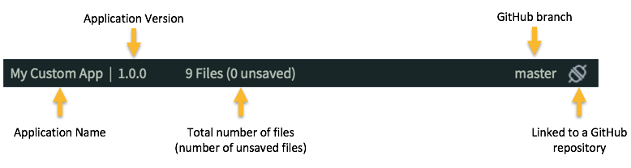
Status Bar
contains information about the application name, application version, the number of files comprising the application, and the source control branch.
Application Name

Slide 13
Status Bar
contains information about the application name, application version, the number of files comprising the application, and the source control branch.
Application Version

Slide 14
Status Bar
contains information about the application name, application version, the number of files comprising the application, and the source control branch.
Total number of files
(number of unsaved files)

Slide 15
Status Bar
contains information about the application name, application version, the number of files comprising the application, and the source control branch.
GitHub branch

Slide 16
Status Bar
contains information about the application name, application version, the number of files comprising the application, and the source control branch.
Linked to a GitHub repository

Slide 17
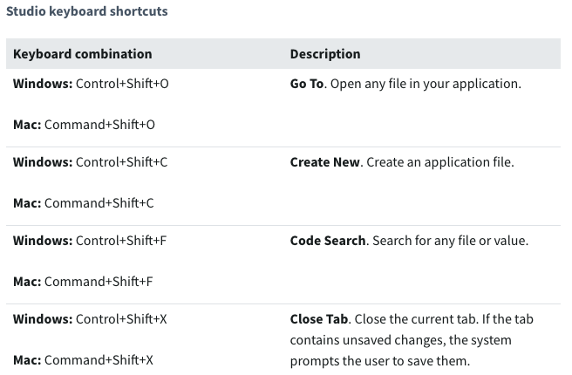
Keyboard Shortcuts
Notes:
Here are the keyboard shortcuts that you can use under ServiceNow Studio

Slide 18
Publish Application
When you select Publish, the sys_app or sys_app_customization record for the application is updated with the new version.
The current state of the application is committed to Source Control, including any untracked or uncommitted changes. The value of the glide.sourcecontrol.default_commit_mode property is ignored.
A Source Control tag is created for the new version and the application is published. If needed, the sys_app record is updated with the new store correlation ID.

Slide 19
Source Control Integration
Enable application developers to integrate with a Git Source Control repository.
Save and manage multiple versions of an application from a non-production instance.
Notes:
Source Control Integration enables application developers to integrate with a Git Source Control repository. Save and manage multiple versions of an application from a non-production instance.

Slide 20
Source Control Integration
Advantages
Import applications from a Git repository.
Pull and apply remote changes from a Git repository.
Commit all local changes on the instance to a Git repository.
Create tags to permanently link to a given version of an application.
Create branches to maintain multiple versions of an application simultaneously.

Slide 21
Source Control Integration
Capabilities
Edit the application repository credentials.
Commit all local changes on the instance.
Apply remote changes from the repository.
Create a branch.
Switch branches.
Import an application from a remote repository.

